Slide 1
Ticket Count Prediction
Problem Statement:
In any organization, accurately predicting the number of tickets expected to be generated within a specific timeframe is crucial for resource allocation, workload management, and ensuring timely resolution of service requests. The goal of this challenge is to develop an AI-driven solution that can analyze historical ticket data and forecast ticket count, enabling better planning and resource optimization.
Domain:
Artificial Intelligence (AI) & Machine Learning (ML)

Slide 2
Team Details
Name of the Team: TriTech
Number of members: 3
Team Leader name: Sakshee Yande
Name of the Team members: Shivangi Safai, Anjali Pokale

Slide 3
Aim of the Project
Aim:
The aim of this project is to develop an AI-driven solution for accurately predicting the number of tickets likely to be generated within a specific timeframe.
How the solution helps?
This solution helps organizations optimize resource allocation, workload management, and timely resolution of service requests by leveraging machine learning algorithms, data analysis techniques, and real-time data integration.

Slide 4
Objectives
Accurate Forecasting: Predict ticket counts using historical data and real-time inputs to ensure accurate resource planning.
Real-Time Integration: Implement a system that can process live ticket data and dynamically update predictions.
Model Development: Train machine learning models capable of understanding seasonal patterns, trends, and external factors influencing ticket generation.
User-Friendly API: Develop an API to allow users to input data and receive instant predictions.
Scalability: Build a solution that supports multiple users and integrates seamlessly with existing organizational systems.
Continuous Learning: Design the system to periodically retrain and improve predictions as new data becomes available.

Slide 5




Technology Stack Used
Programming Language: Python (for model development and API creation).
Frameworks: Flask or FastAPI (for building APIs).
Libraries:
pandas, numpy (data preprocessing).
scikit-learn, xgboost (machine learning models).
joblib (model saving/loading).
Database: MySQL, MongoDB (storing ticket data).
Deployment: Heroku, AWS, or Google Cloud.
Testing Tools: Postman, Pytest.
Version Control: GitHub.

Slide 6
Prototype Implementation And Analysis
1.We started about the solution by following a dataset appropriate dataset with features. We started with basic features first that is ticket id, month, timestamp.
2.Later on we started our model analysis where we find out that models like linear regression, random forest , KNN, Light BGM ,ANN showed the accuracy around 50-60%.
3.We then preferred the XGboost model that came up with accuracy of around 75-80% with RMSE(root mean square error) of 26.74 for range of ticket counts in 30-300.
4.Hence we explored the model and also improved the performance using xgboost regressor which gave accuracy nearly greater than before.

Slide 7
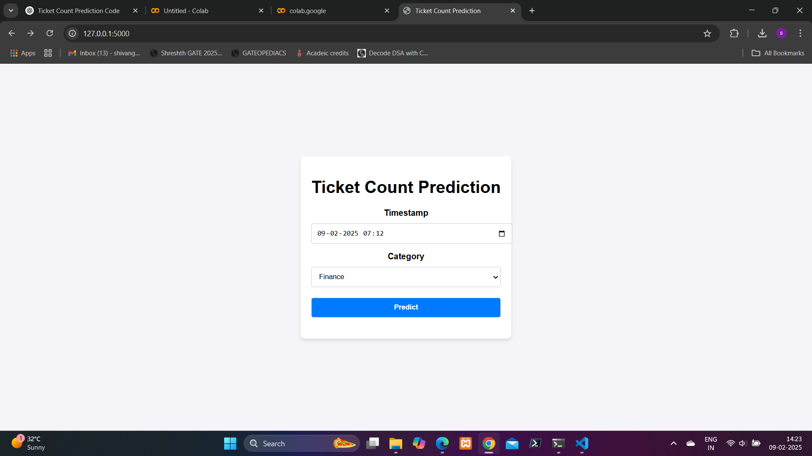
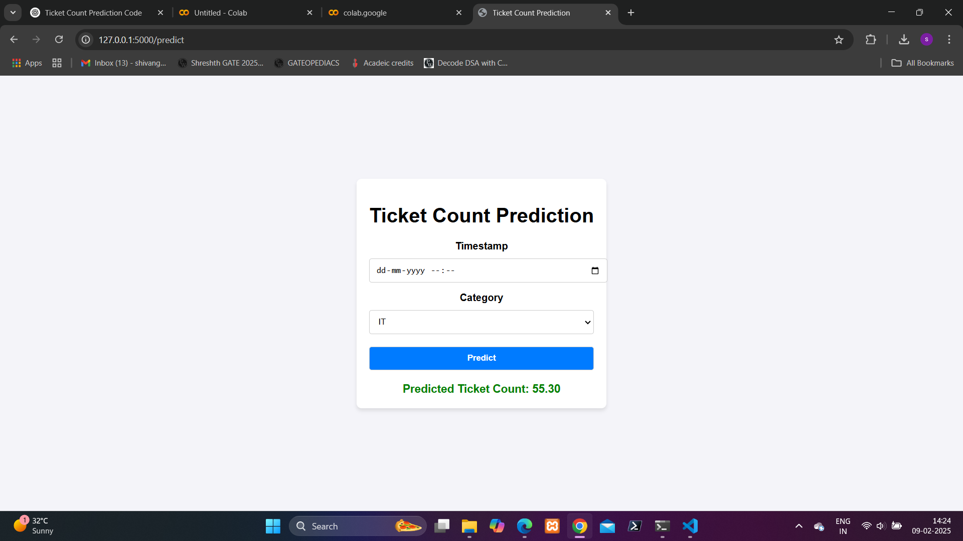
These are the photographs of the model we implemented

Slide 8
4.Further we are working on the model by more further improvements like we are adding more features to it that will make it stand out in performance and accuracy.
5.Further proceedings with the real time integration we are going to use the pipeline for integrating real time data and collect it and then tune the model the same
6. Lastly deploying it on cloud.
7. Here, we have presented our basic working prototype or first stage model that is predicting the ticket count based on the timestamp and the category selected by the user. The previous slide contain the snapshots of the same. The next slides discuss the application of such prediction and following trends associated with it.

Slide 9
Applications and Trends
APPLICATIONS:
IT Support: Efficient management of IT helpdesk tickets.
Customer Service: Improved handling of customer queries.
Healthcare: Predicting appointment demand and resource needs.
Logistics: Optimizing supply chain and shipment tracking.
Manufacturing: Predictive maintenance to prevent equipment failure.
TRENDS:
Integration of AI with cloud computing for real-time predictions.
Use of Natural Language Processing (NLP) for automated ticket classification.
Advancements in deep learning for more precise forecasting.
AI-driven chatbots for initial ticket resolution.
Adoption of explainable AI (XAI) to improve model transparency.

Slide 10
THANK YOU !

